Slide 1
NYC TAXI TRIP TIME PREDICTION
V.VYSHNAVI
221FA14055
3-BI-A

Slide 2
INTRODUCTION
The New York City taxi system is one of the largest and busiest in the world, with over 600,000 trips taken daily. Accurate trip time prediction is crucial for: 1. Improved passenger experience 2. Enhanced traffic management 3. Increased operational efficiency 4. Better fleet management

Slide 3
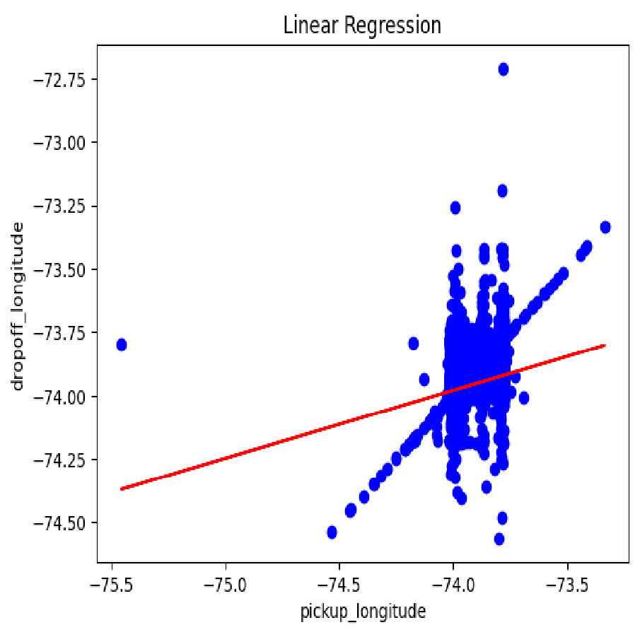
OUTPUT OFDATA IN PYTHON USING GOOGLECOLAB
Scatter Plot (blue dots): Represents the relationship between two variables: pickup_longitude (x-axis) and dropoff_longitude (y-axis). Each blue dot represents an observation with its pickup_longitude and dropoff_longitude coordinates.
Linear Regression Line (red): A straight line representing the best linear fit to the data points. It shows the general trend between the two variables, indicating that as the pickup_longitude increases, the dropoff_longitude also tends to increase

Slide 4
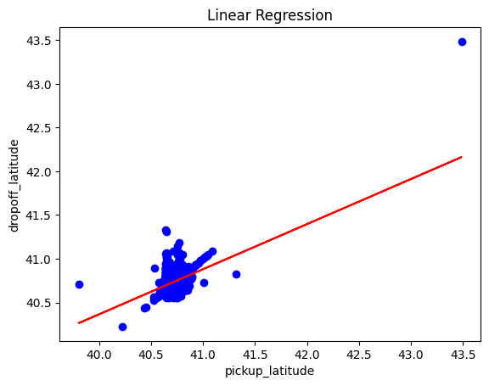
OUTPUT OF DATA IN GOOGLE COLAB
Scatter Plot (blue dots): Displays the relationship between two geographical coordinates: pickup_longitude (x-axis) and dropoff_longitude (y-axis). Each blue dot represents a single observation pairing these two variables.
Linear Regression Line (red): A straight line that best fits the data points on the scatter plot. It shows that there is a general upward trend, indicating that as pick up Latitude increases, the drop off Latitude also tends to increase.

Slide 5
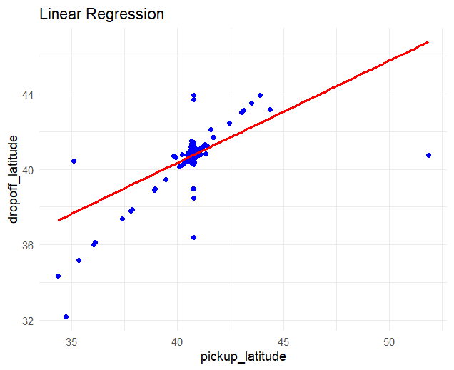
DATA IN R - USING R STUDIO
Linear Regression Line (red): The red line represents the best fit linear model. The upward slope suggests a positive correlation between pick up Latitude and drop off latitude, meaning that as the pick up Latitude increases, the drop off latitude also tends to increase.
Scatter Plot (blue dots): The blue dots represent individual data points, where each point reflects the latitude coordinates of both pickup and drop off locations.
Data Distribution: Most of the data points are concentrated near the center, particularly around the latitudes of 40, indicating that most pickups and drop-offs occur in this range. However, there are a few outliers scattered at different points, particularly at lower latitudes (around 32-36) and higher latitudes (above 44).

Slide 6
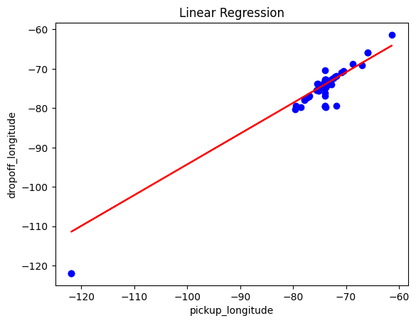
DATA IN R-USING R-STUDIO
Blue Dots (Scatter Plot): These represent individual observations where the latitude of the pickup location is plotted against the latitude of the drop off location.
Red Line (Linear Regression Line): The red line indicates the best fit linear model for the data points. It shows a positive correlation between the two variables—generally, as the pick up latitude increases, the drop off latitude increases as well.
Data Distribution: Most of the data points are concentrated around the pick up latitude range of 38-42, indicating a cluster of pickups and drop offs in this range. A few outliers appear below 36 and above 44 on the y-axis, showing some irregular or distant drop off latitudes.

Slide 7
THANK YOU

